Slide 1
Automating Generative Deep Learning for Artistic Purposes: Challenges and Opportunities
https://arxiv.org/pdf/2107.01858.pdf

Slide 2
Introduction
The author build an Auto artistic generative deep learning framework which combine the core concepts from the Auto ML methods and the theory and practice of computer creativity(CC) research. Auto artistic generative DL could be utilized for artistic applications.

Slide 3
Automated, Artistic Deep Learning as Co-Creation
both the human artist and the computer take creative responsibility for the generation of a creative artefact. There are two strategies for this human-computer interaction.
1.task-divided: Both human and computer are distributed with certain different tasks.
2.Alternating co-creativity: both partners(human and computer) take turns in creating a new concept satisfying the requirements of both parties.
This kind of co-creation could free human artist from certain manual work. Since human’s creativity is also limited due to the bounded rationality, computer could complement this shortcoming.

Slide 4
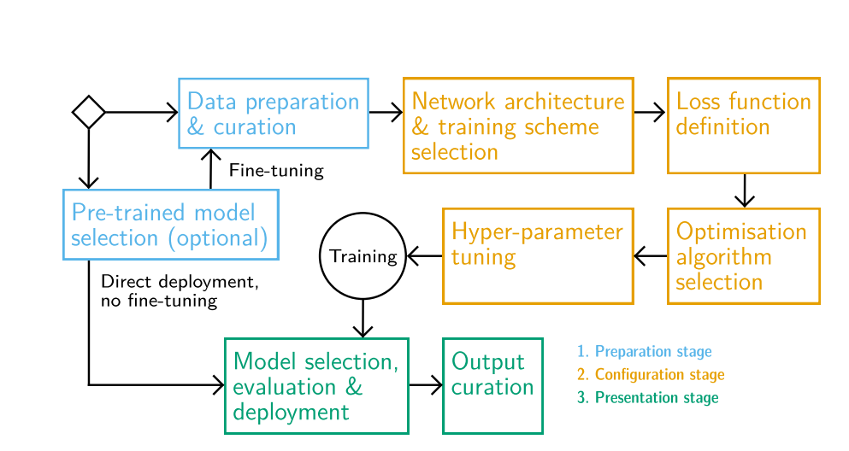
The framework of Auto artistic generative DL

Slide 5
Stage 1: prepare stage (gather relevant materials)
Data preparation and curation
1. Data Acquisition: there are two main methods for gathering data:
Using existing datasets: In a research setting, it is most common to use standard benchmark data sets for training and evaluating models. In this case, artist could scrape samples from 1. artist’s private artworks for introducing desirable bias and ensure the quality of output. 2. internet for the surprising result generation.
Creating a new datasets: Since the existing available dataset are limited, artists could produce synthesis data to supplement the original data set to maximize the variety of artefacts that are different from each other. However, it is extremely time-consuming and nontrivial to create the high-quality and large amount of new data sets satisfying the aesthetic requirement.
2. Data cleaning, augmentation and transformation of data samples.
3. Data curation: in common setting, if the noise contained in a sample is smaller, the better the quality of this sample. However, for artistic purpose, the noise is often needed. Thus the further data refining would be needed.
Pretrained model selection(optional if not available)
If there is an appropriate pretrained model available, then the datasets shortage problem from the section1 could be happily resolved. Researcher could either fine-tune the pre-trained model on a limited high-quality datasets but still with a good performance or just directly put it into use.

Slide 6
Stage2: configurative stage (the models, training regimes and parameters are tuned to produce valuable output)
Network architecture and training scheme selection:
Such as the Neural architecture search (NAS), this target for finding the best architecture. The author recommend here to use the tried-and-tested architecture by only altering the parts with a direct influence on the output.
Loss function:
The loss function would highly depend on the architecture and constitute the basic requirement for successful training. In order to satisfy the aesthetic requirement, additional loss term could supplement or change the basic term.
Optimization algorithm
The optimization algorithm needed for tuning the model’s parameters. It would finish this task similar with the algorithm of gradient decent, but the specific algorithm selection could highly depend on the Architecture.
Hyper parameter tuning
Optimization of batch size, learning rate, momentum, etc. can be achieved via AutoML methods, and there is much active research in this area.

Slide 7
Stage3: presentation stage(user deploy a final model and curate the output)
Model selection and evaluation:
Finding the best model from all the possible models depend on the specific criteria. In traditional ML project, the main concern is the predict accuracy. However, for the artistic generative project, other considerations may include how surprising the outputs are, synthesis speed (for tool or real-time uses) and coherence of the results. Each of these consideration would be given a weight and the final criteria would employ the weighted sum of metrics.
Output curation(raise the overall output quality)
Filtering: ranking samples from a large batch of model outputs via given metrics.
Search: searching for vectors directly in a model’s latent space via exhaustive search like grid search or random sampling.

Slide 8
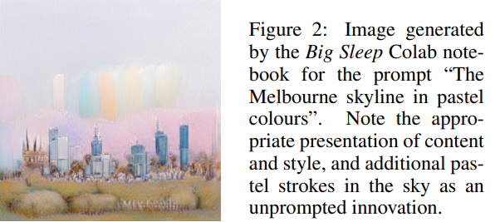
An Illustrative Example

Slide 9
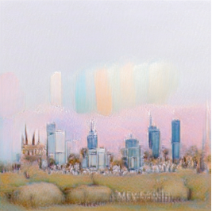
implementation
data preparation and curation: imaginative text prompts.
pre-trained model selection: GANs
loss function definition: employing patches from generated images rather than the entire image to evaluate its fit to the prompt.
hyper-parameter tuning: standard AutoML techniques
model selection and deployment: creative web-services (Veale, 2013), with higher-level CC systems accessing text-to-image generators in a variety of projects
Output curation: cherry picking results for posting on social networks and in blogs.

